Slide 1

Case Study: GEF
Group 7

Slide 2

About GEF India Private Ltd
Founded in 2009 in Andhra Pradesh
Edible oil company
GEF had planned to manufacture and market refined oils and fats across India with a focus on south India.
Started by Mr Pradeep Kumar Chowdhry
Launched their Sunflower Oil Brand Freedom in February 2010
GEF established two oil refineries which was worth a total investment of 150Cr INR

Slide 3
Why Edible Oils Industry?
First-generation professional turned entrepreneur Pradeep. K Chowdhry
Worked in ITC Agro Tech(Sundrop), ICI, Britannia, etc
30+ years of Work Experience in Edible oils Industry
Developed keen interest for edible oils business.

Slide 4
Edible Oil Industry
Edible oil market is a commodity market.
Low profit margins
Popular oils : Palmolein, Groundnut, Sunflower.

Slide 5
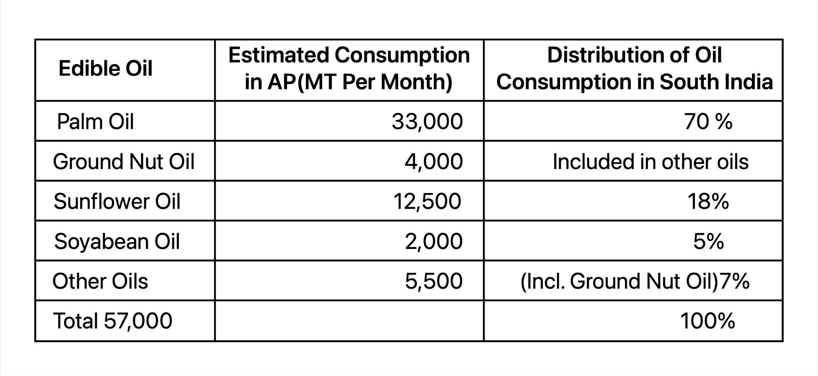

Slide 6
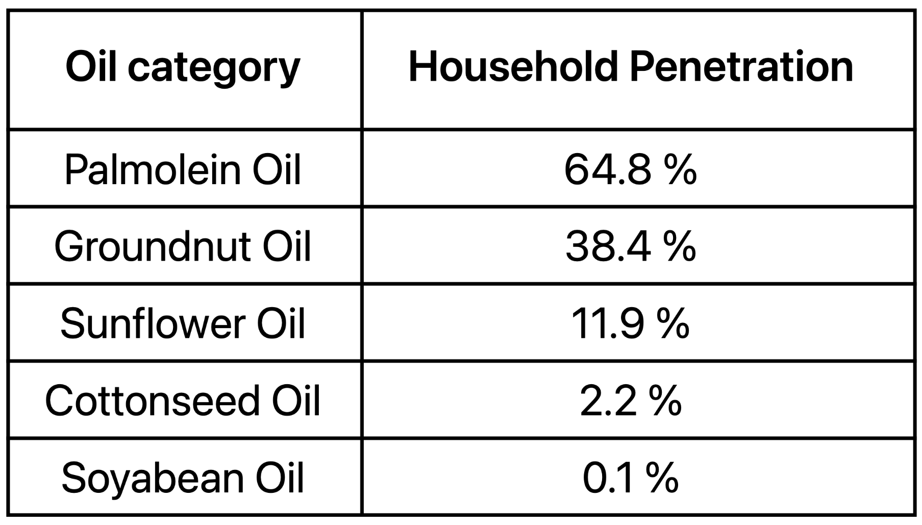

Slide 7
Market Research by GEF Management
Market was divided into three categories Premium, Popular and Price Driven.
Premium Segment : Saffola and Sundrop
Value for Money : Gold Drop, Vijaya, Priya, Crystal, Fortune(National)
Gold Drop was dominant in the Telangana and around Hyderabad.
Crystal was strong in other places in AP.

Slide 8
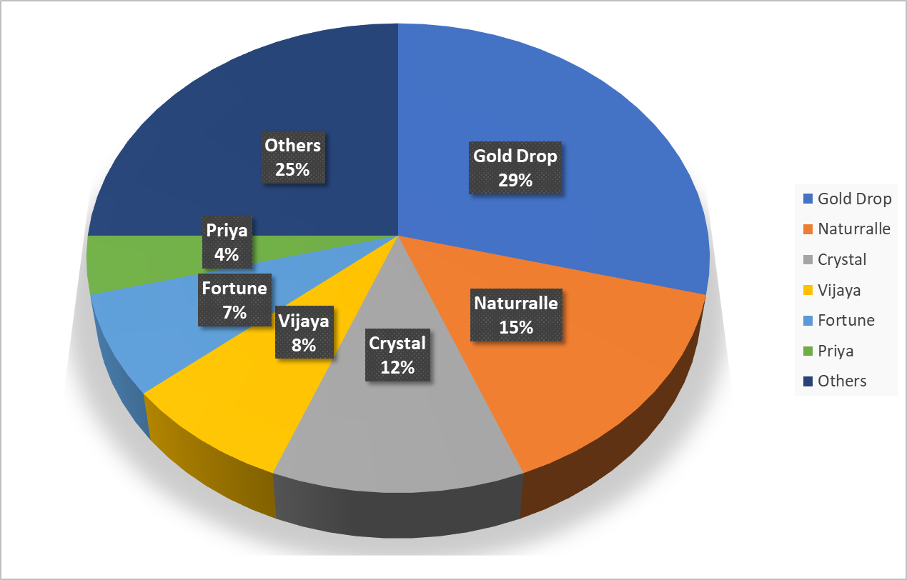

Slide 9
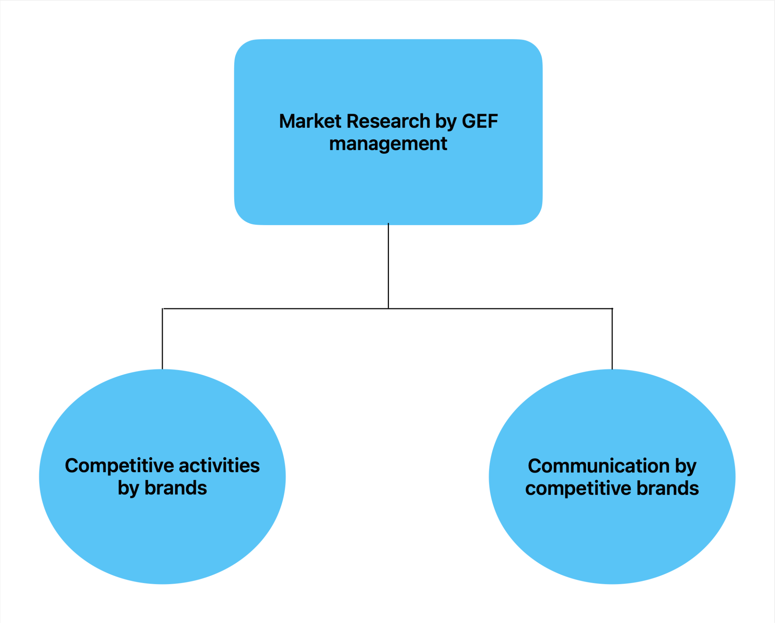

Slide 10
Media Presence of Competitors
Gold drop brand advertised moderately in regional mass media
Priya was part of the Eenadu group, advertised mainly on ETV and Eenadu newspaper.
Fortune, another Adani Wilmar trademark, is promoted nationwide. In 2009, Fortune state media spending were low.

Slide 11
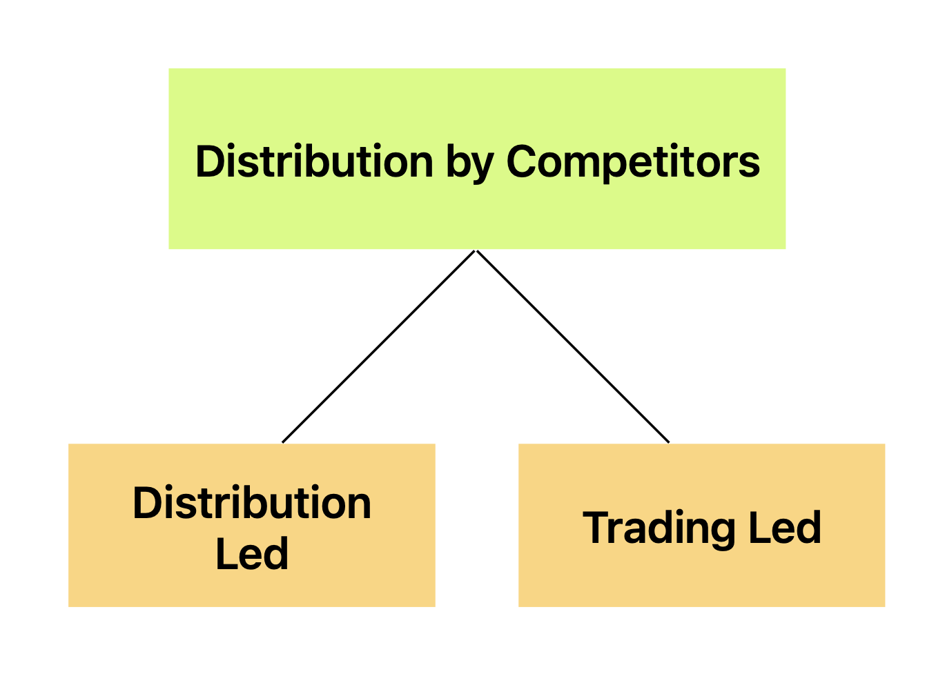

Slide 12
SWOT Analysis
Strength
Pradeep Kumar’s extensive 30 years of industry experience in the Edible Oil Industry, including at ITC Agro.
Distribution targets were customized to suit the distinct market of diverse towns and regions.
Set competitive pricing below market leader can attract price - sensitive consumers.
Prioritizing retailer engagement, the company utilized indirect customer outreach channels to enhance brand promotion.

Slide 13
Weakness
Insufficient market research conducted only on product name and packaging before launch.
10 days credit with 1:3 BG/SD
Lower pricing
Strict cooking oil regulations limited scope for product differentiation.

Slide 14
Opportunities
Focus on pan-India expansion of brand
Consider diversifying into mustard oil, rice bran oil, and coconut oil to expand product offerings.
Should focus on lower middle urban class and rural India.
Explore acquiring smaller brands to expand market presence strategically.
Benefit from rising sales of pre-packaged oil as health-conscious customers prioritize healthier choices.

Slide 15
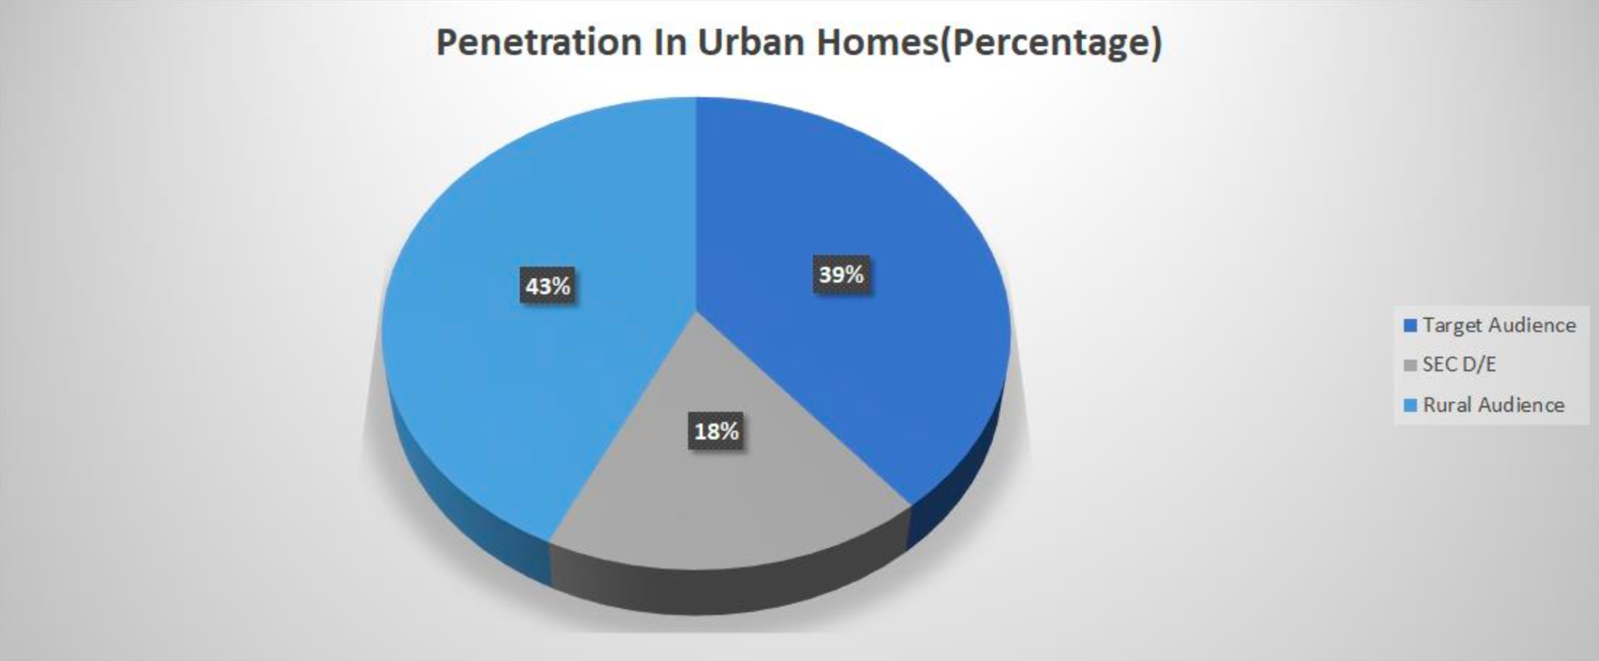

Slide 16
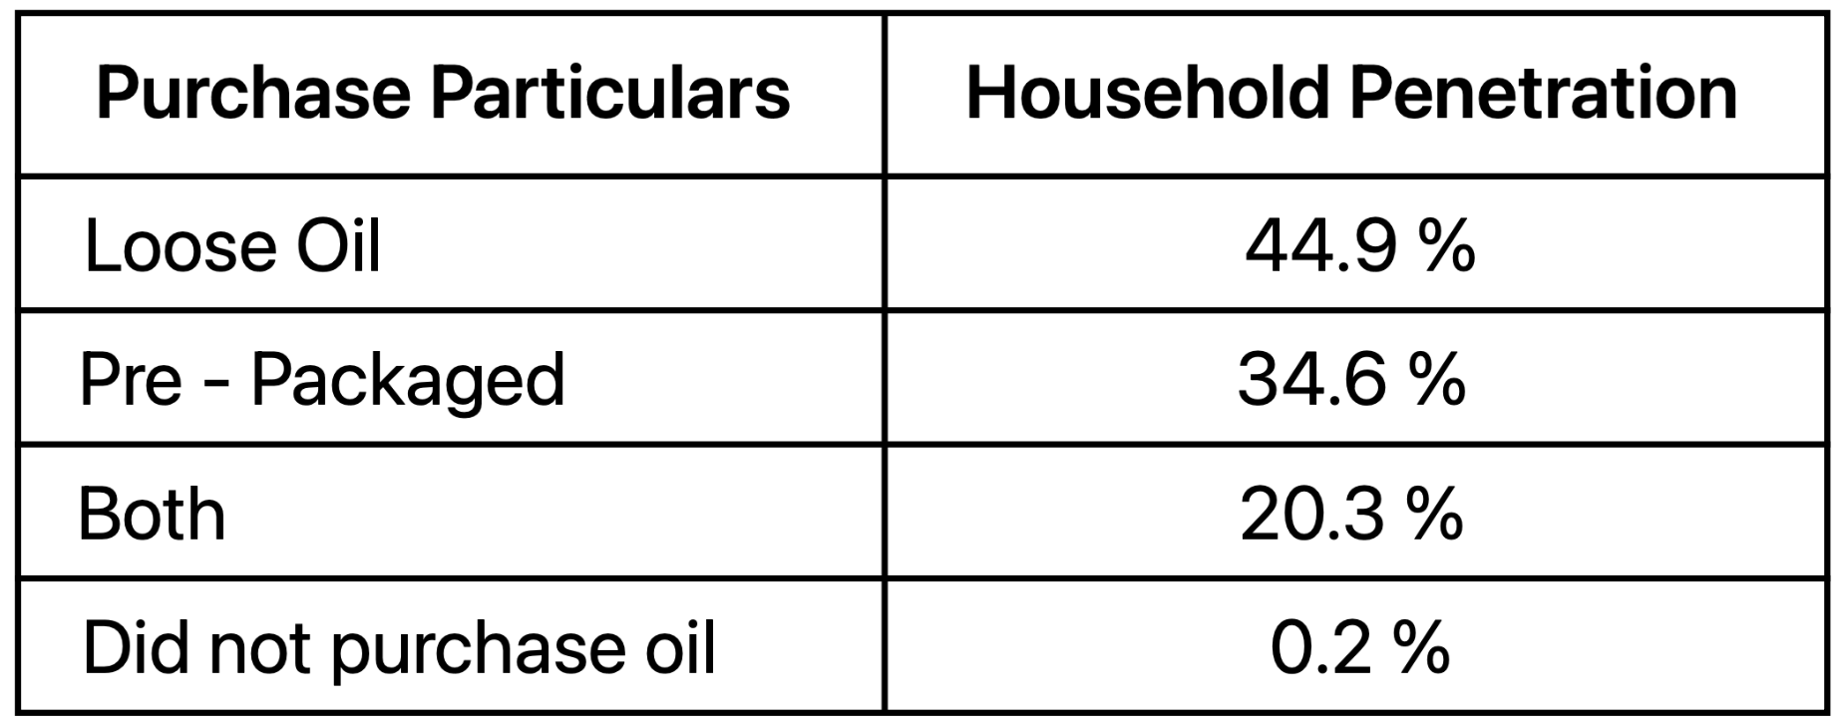

Slide 17
Threat
Lower Pricing compared to competitions may imply lower product quality.
As population prioritizes health, they may prefer healthier alternatives like ghee or air fry.

Slide 18
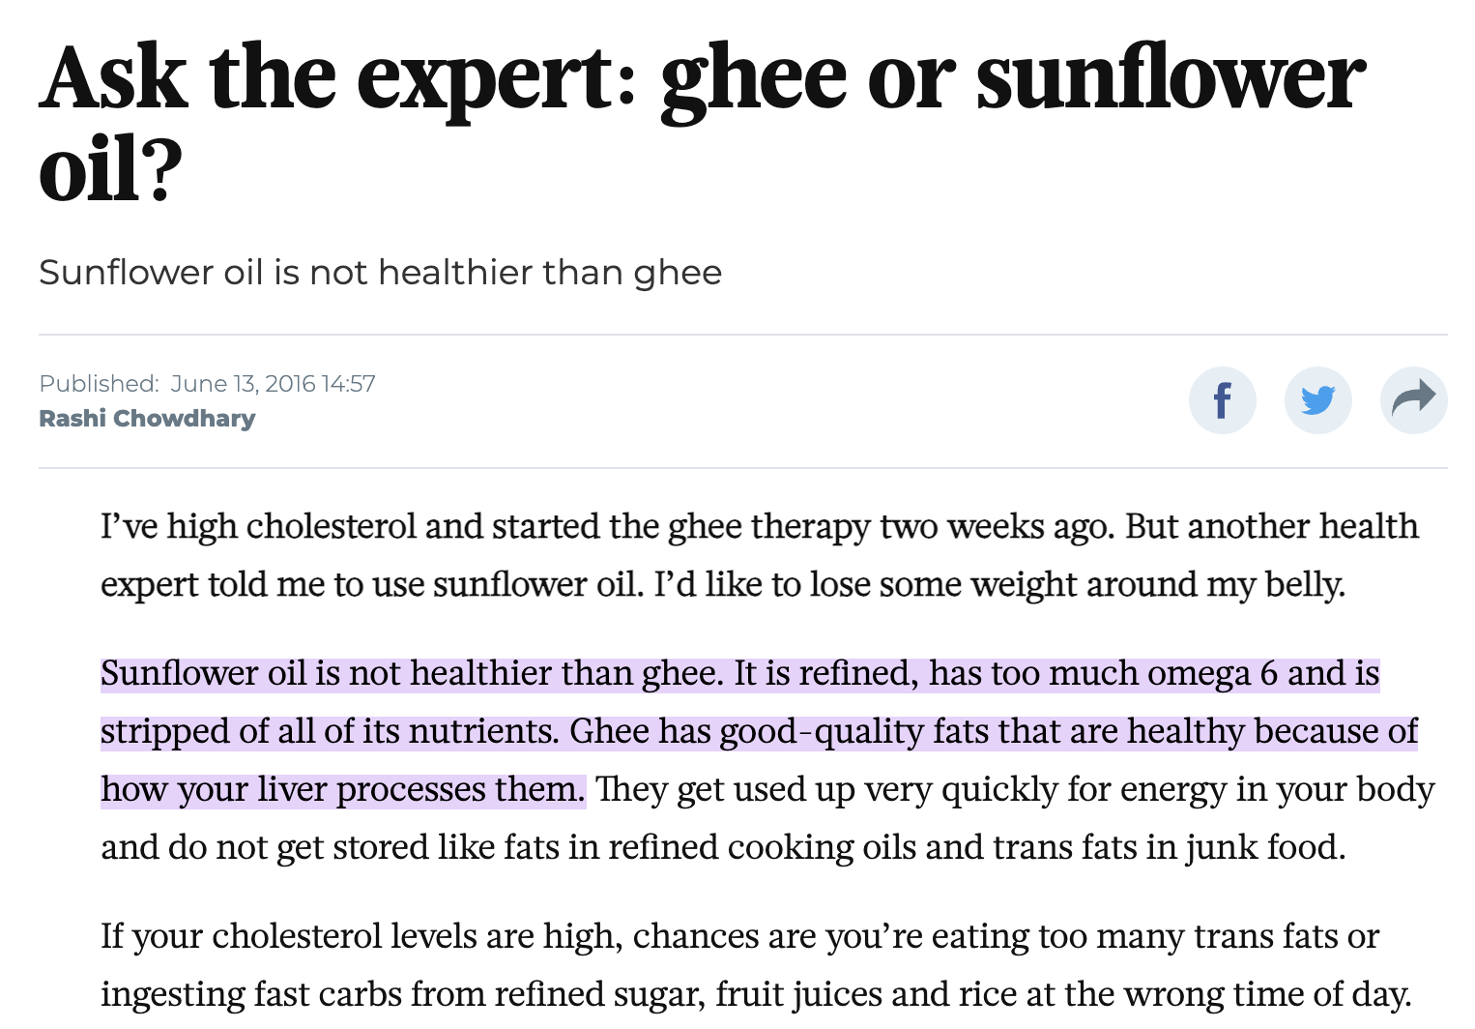

Slide 19
4 P’s Analysis
Product
Sunflower oil - value for money category.
Brand name - Freedom
Focus on quality, naturalness of oil and health
Tagline “your right to happiness”
Three type of packaging - pouches(500 ml and 1lt), jar(5lts), tin(15lts)

Slide 20
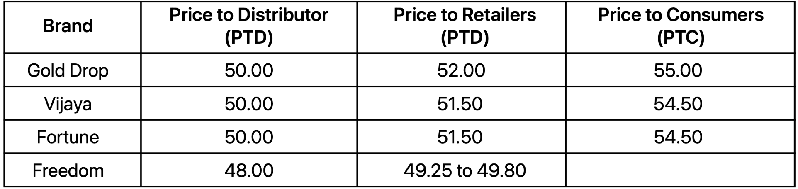
4 P’s Analysis
Price
Price was kept below that of Brand Leaders.
Sales scheme for retailers was introduced.

Slide 21
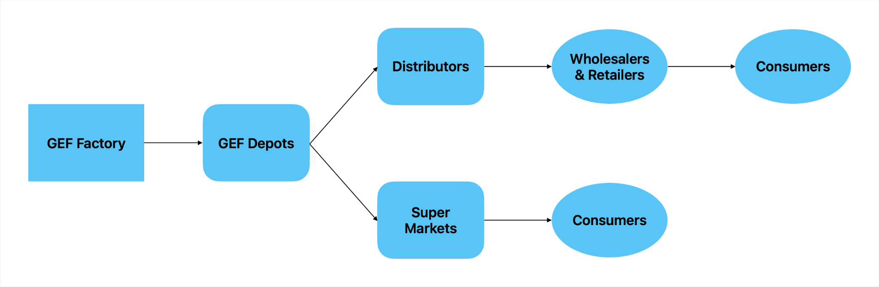
4 P’s Analysis
Place
Distribution targets were set differently for different markets.(Coastal AP, Telangana)
Large distributors bought directly from the factory

Slide 22
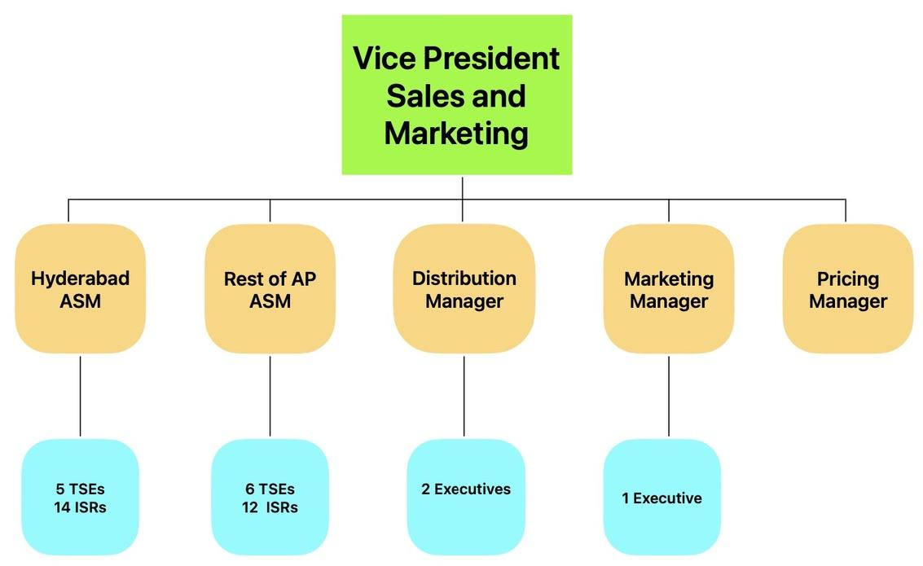
Structured organization of Sales and Marketing

Slide 23
4 P’s Analysis
Promotion
TV only (cheapest)
Target consumer: woman, 25+ years, SEC A, B, and C class
Two phases: Intensive first phase (5-week launch campaigns),
Consumer phase cycle (last week and first week of the month)
Sponsoring "Maa Voori Vanta" cookery show
Two retailer promotion schemes for the first 6 months
Budget: INR 1.50 crores from May to December 2010

Slide 24
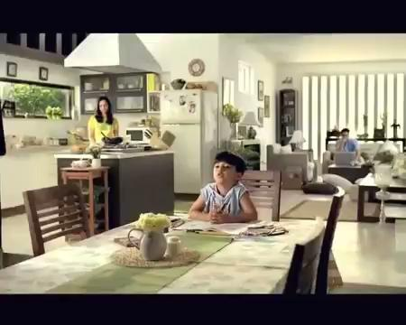
https://www.youtube.com/watch?v=NoZMaWRCVmg

Slide 25
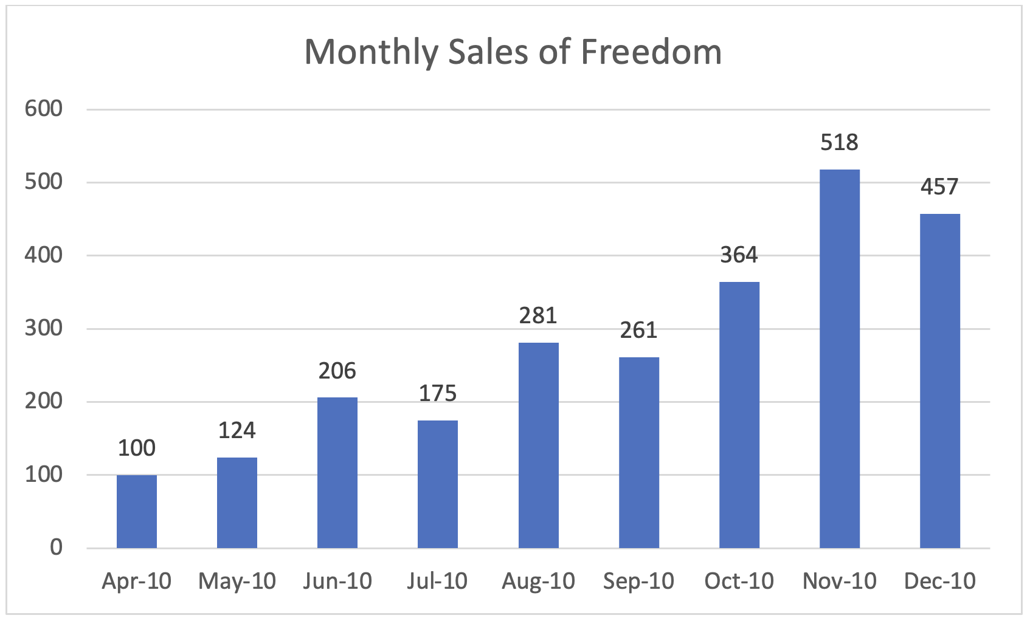

Slide 26
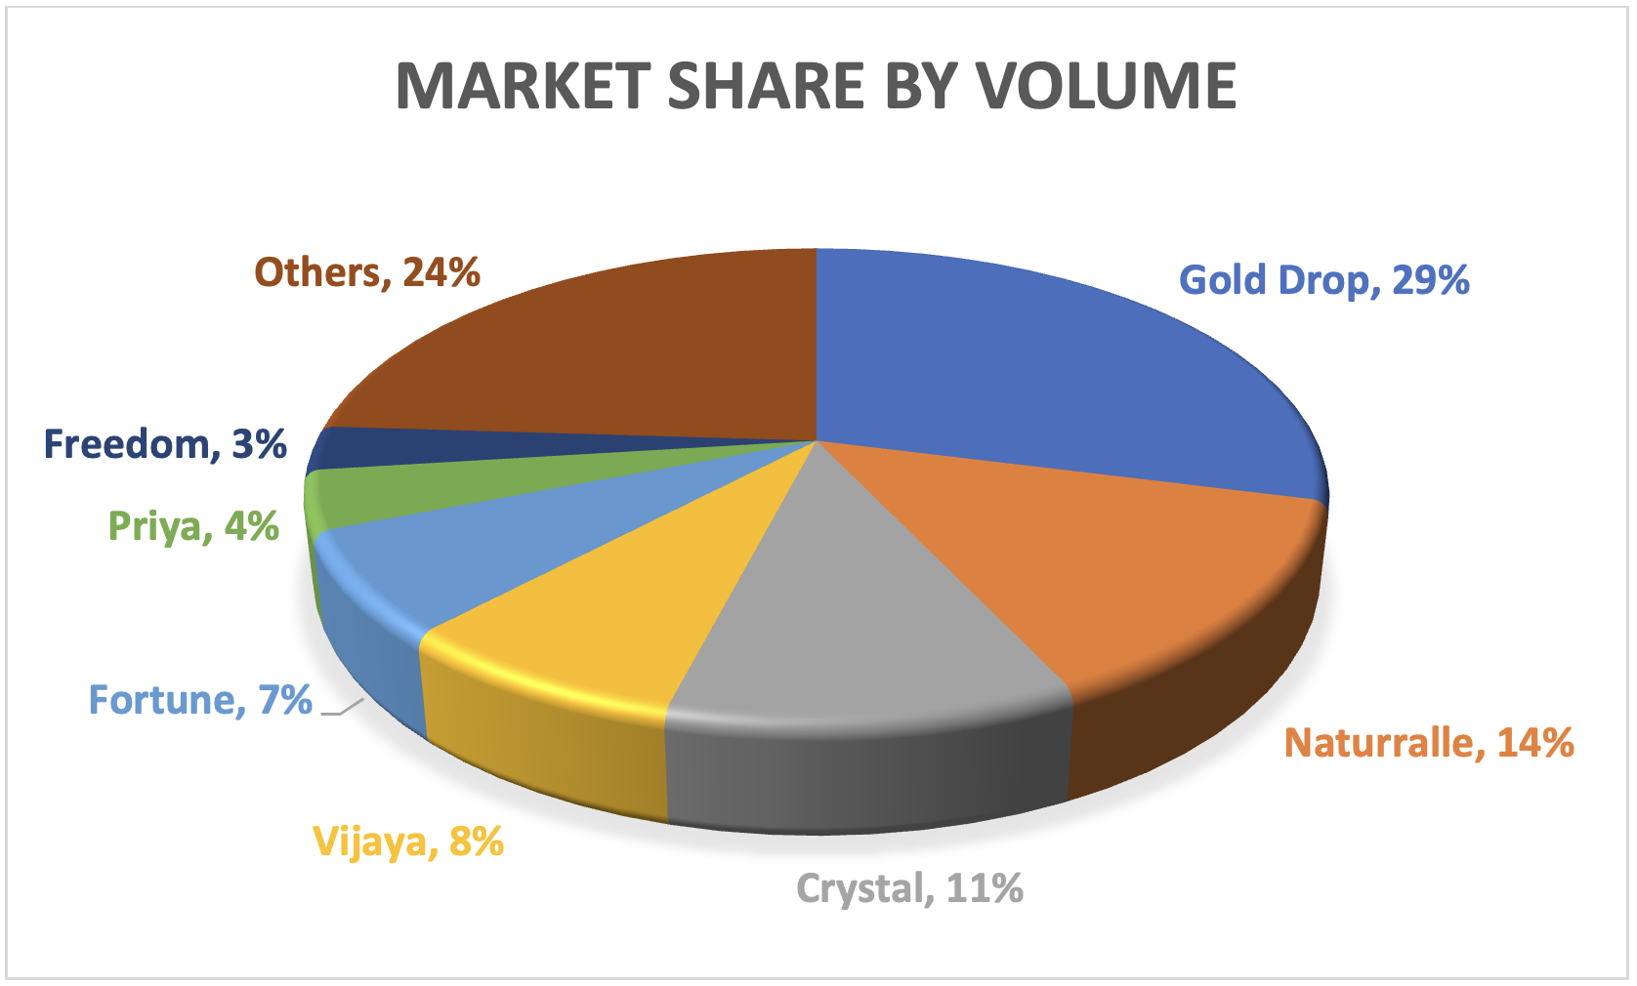

Slide 27
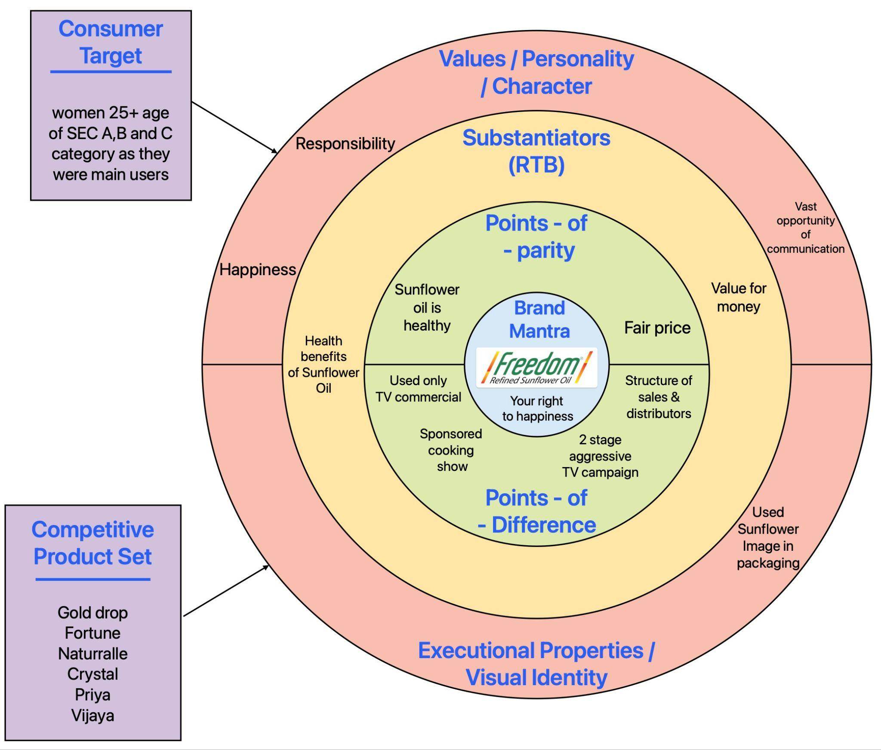
Marketing Positioning

Slide 28
Freedom Sunflower Oil: Creating a Value
Freedom achieved 3% market share, indicating customer satisfaction.
Product positioned as healthy, value-for-money for upper and middle class.
Success of sunflower oil led to brand diversification in other oil businesses.
Customer loyalty fostered through retail schemes during initial 6 months of launch.
https://www.exchange4media.com/marketing-news/we-have-been-growing-at-35-cagr-while-the-market-has-been-at-over-10-127405.html

Slide 29
Brand Growth at Present
The largest sunflower oil brand in India
Currently a market leader in four Indian states
Plants have the latest technology
Met the increased demand with low processing and packaging costs.
The size and scale of manufacturing capacity give the edge.

Slide 30
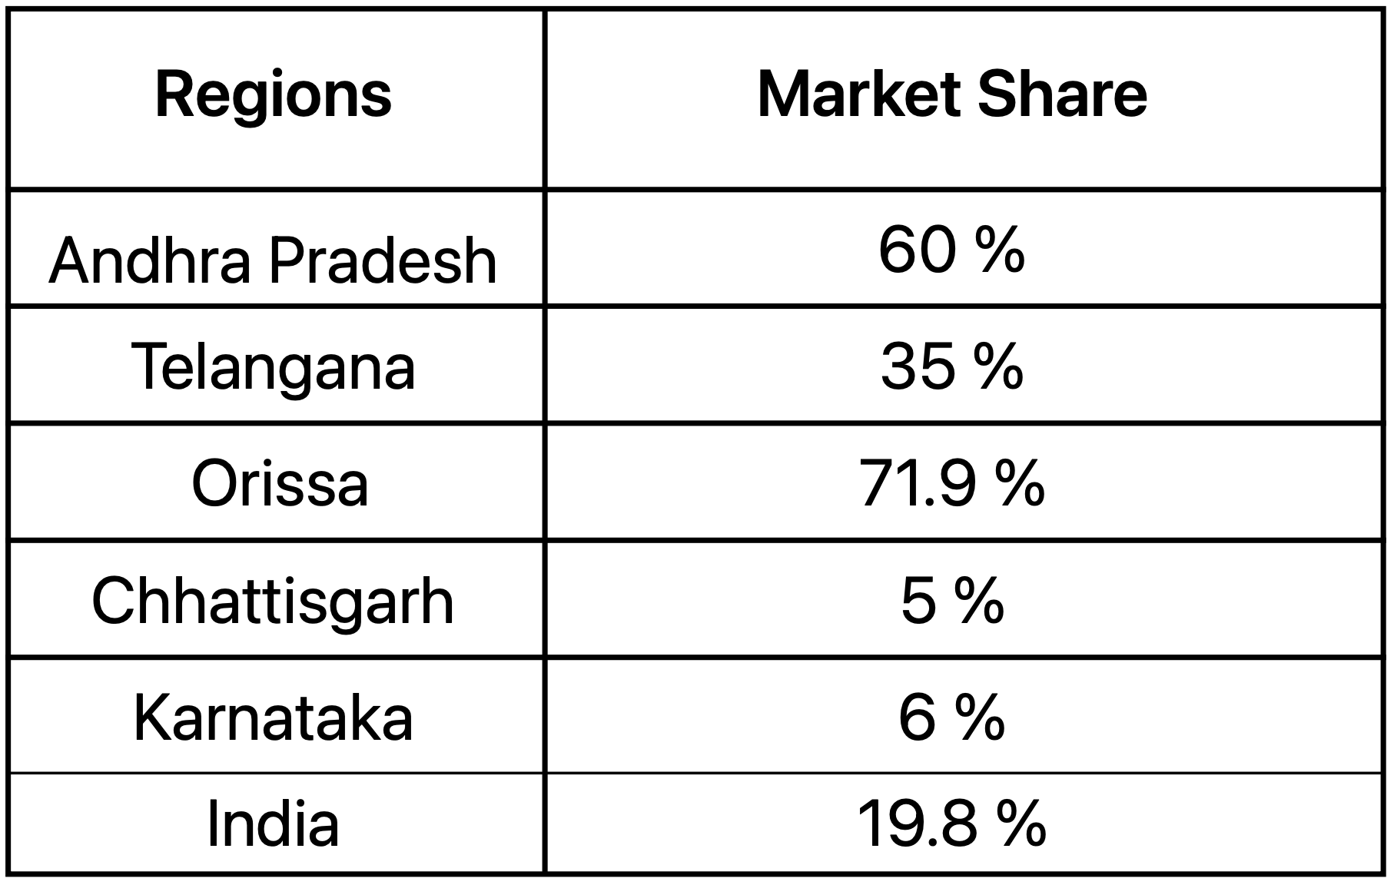

Slide 31
Brand Promotion at present
Currently using the digital platform.
Partnered with Google and shared data.
Spent a lot on YouTube and other mediums.
Collaborating with cookery shows on the OTT platforms.

Slide 32
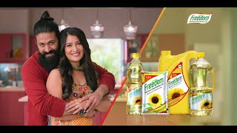
https://www.youtube.com/watch?v=yrBGdgSVjHU

Slide 33
Thank you….
Have the FREEDOM to pursue your happiness….

